Slide 1
FTIR - SOME LESSONS LEARNED
Mike Sherer, Trinity Consultants
May 25, 2017

Slide 2
UNDERSTANDING PROCESSES AND CHEMISTRIES

Slide 4
AMMONIUM COMPOUNDS FORMATION
Ammonium compounds are formed when ammonia and acid gases meet in exhaust system.
NH₃ + HF → NH₄F
NH₃ + HCl → NH₄Cl
2NH₃ + SiF₄ + 2HF → (NH₄)₂SiF₆
From above ammonium compounds and if you want to measure ammonia and acid gases, need to review what happens to ammonium compounds in sampling system and Fourier transform infrared (FTIR) spectroscopy.
Notes:
4

Slide 5
ABATEMENT DEVICES DRE
FTIR measures concentrations in parts per million by volume (ppmv).
Destruction and removal efficiency (DRE) is calculated by inlet and outlet mass rates.
% DRE = ((inlet mass rate) – (outlet mass rate))(100%)
        (inlet mass rate)

Slide 6
UNDERSTANDING SAMPLING LOCATIONS

Slide 7
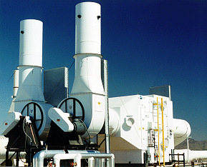
CENTRALIZED ACID SCRUBBER

Slide 8
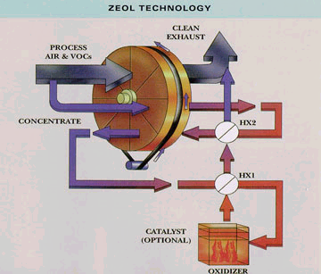
ROTOR CONCENTRATOR/THERMAL OXIDIZER (RCTO)

Slide 9
FTIR SAMPLING METHODS EXAMPLES

Slide 10
USEPA METHOD 320
Utilizes FTIR.
Continuous measurements of hydrogen chloride, hydrogen fluoride, greenhouse gases (GHGs), organic compounds, etc.
Cannot not be used for mononuclear diatomics and inert gases.
ASTM D6348-12 has been used instead of USEPA Method 320.

Slide 11
2014 ISMI Environmental Characterization Guideline (SEMICONDUCTOR INDUSTRY)
The ISMI Guideline for Environmental Characterization of Semiconductor Process Equipment – Revision 3 was published in 2014. First published in 2001 and revised in 2006, 2009 and 2014.
This document provides guidance to device manufacturers and equipment suppliers on how to characterize air emissions including gaseous and particulates/powders, liquid effluents and solid wastes of their tools and processes.

Slide 12
2014 ISMI GUIDELINE ANALYTICAL METHODS
Protocols are provided for the analytical methods recommended for collecting the data
  Quadrupole mass spectrometry (QMS)
  FTIR
  Fluorine gas analysis based on chemiluminescence
Additional analytical methods can be used if acceptable by regulatory agency and recognizable accreditation.

Slide 13
EPA FLUORINATED GREENHOUSE GAS TESTING PROTOCOL
EPA published in March 2010 the Protocol for Measuring Destruction or Removal Efficiency (DRE) of Fluorinated Greenhouse Gas Abatement Equipment in Electronics Manufacturing, Version 1.
The purpose of the Protocol is to provide a practical and reliable method for measuring DREs of POU abatement systems for fluorinated greenhouse gases used during the manufacture of electronics products.
Note: it should also be able to be used for nitrous oxide (N₂O) and methane (CH₄).

Slide 14
SAMPLING SCHEMATIC

Slide 15
40 CFR PART 98 SUBPART I APPENDIX A POINT-OF-USE (POU) ABATEMENT SYSTEM EFFLUENT VOLUMETRIC FLOW RATE
Introduce the non-reactive, non-native gas used for determining total volume flow and dilution across the POU abatement device at a location in the exhaust of the POU abatement device.
Can inject at POU abatement device inlet if no abatement DRE of non-reactive, non-native gas.

Slide 16
FLOW TRACER INJECTION DYNAMICS AT THE POU ABATEMENT SYSTEM EFFLUENT
X
Volumetric
Flow Meter
Main Header
FTIR or QMS
~1’
POU Effluent Flow
Volumetric
Flow Meter
Venturi Pump
(~5 lpm)
0.5L
MFC
POU
System
5L
MFC
SF₆ Tracer Gas
Kr Tracer Gas

Slide 17
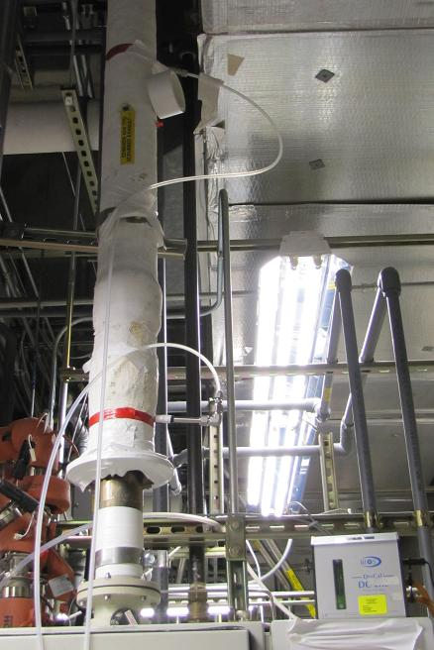
SAMPLE AND TRACER INJECTION LOCATION OF POU ABATEMENT SYSTEM #1
Extraction Location
SF₆ Tracer Injection Location

Slide 18
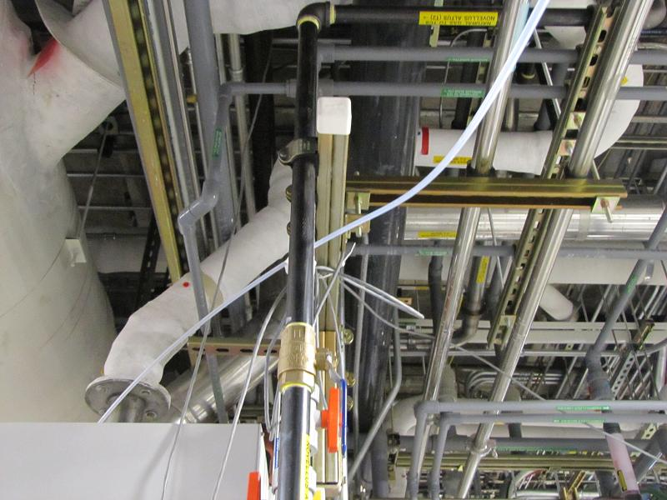
SAMPLE AND TRACER INJECTION LOCATION OF POU ABATEMENT SYSTEM #2
Extraction Location
SF₆ Tracer Injection Location

Slide 19
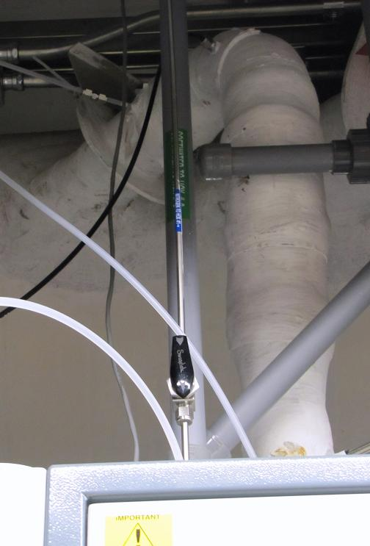
SAMPLE AND TRACER INJECTION LOCATION OF POU ABATEMENT SYSTEM #3
Extraction Location
SF₆ Tracer Injection Location

Slide 20
ADDITIONAL SAMPLING THOUGHTS
(1 OF 2)
Review the need to remove all filters, minimize metal and heat all lines/probes to FTIR if particles are part of what you are analyzing for (e.g., ammonia and hydrogen fluoride in presence of ammonium fluoride). FTIR needs to be 150°C or higher to measure certain dissociable compounds. Assess impact on FTIR equipment.
Determine how to handle below detection limit data when averaging above detection limit data.
How should test run data be averaged if all values are below detection limit. Good to consult with local regulatory agencies, even if not compliance test.

Slide 21
ADDITIONAL SAMPLING THOUGHTS
(2 OF 2)
Include a person knowledgeable in specific process emissions in and out of abatement device to review sampling methods to ensure best data. For example, other contaminants in stream sampled could be interferences with contaminants trying to be measured.
FTIR data may need to be reprocessed by same test company or another test company if data appears to be technically unsound.
Develop a detailed test plan even if not a compliance test.

Slide 22
SOME FTIR ADVANTAGES
Easier and less expensive to use for multiple semiconductor process gases and byproducts (except mononuclear diatomics and inert gases).
Does not need calibration as often as other instrumentation.
Can reprocess data after the testing is done, including determining unknowns.
FTIR method is approved by United States EPA for determining point-of-use abatement device effluent volumetric flow rate through 40 CFR Part 98 Subpart I.

Slide 23
SOME FTIR DISADVANTAGES
Cannot be used for inert gases and mononuclear diatomics.
Some compounds are difficult to quantify at low detection limits due to interferences from other compounds.

Slide 24
ADDITIONAL FTIR TESTING LESSONS LEARNED
It is essential to provide for air leak checks for the entire sampling system, including analytical equipment. Air leaks have been found with fittings, in FTIR, etc.
Nitrous oxide (N₂O) concentrations, especially at POU abatement device inlet, can be very high and may not be linear with FTIR. This will provide inaccurate DRE results.
A low-flow process pump purge (e.g., 15 lpm) could be sampled at 5 lpm, which would lead to 33% of POU inlet flow not being abated by POU abatement system.

Slide 25

Questions?

Slide 26
Contact Us
Mike Sherer – msherer@trinityconsultants.com
Trinity Phoenix
  1661 E Camelback Road, Suite 290
  Phoenix, AZ 85016
  Phone: 602-274-2900
  http://www.trinityconsultants.com/phoenix/

Slide 27
Stay Informed on Emerging Issues www.trinityconsultants.com
Environmental Training and Online Registration
Free Seminars/Webinars and Online Registration
eNews – Federal and State Regulatory Updates
Environmental Quarterly
Notes:
27

Slide 28

Connect with Trinity
http://www.linkedin.com/company/trinity-consultants
http://www.facebook.com/TrinityConsults
http://twitter.com/trinityconsults
http://www.youtube.com/trinityconsultants

